Slide 1
3. Arrays

Slide 2
3. Arrays and Linear Algebra
Vectors and Matrices
Creating
Addressing
Functions
Linear Algebra
Operators
Functions
Other Types of Arrays
Converting Between Array Types

Slide 3
Vectors
Columns
A = [a1 ,a2 , a3 , … , an];
A = [a1 a2 a3 … an];
Rows
A = [a1 ; a2 ; a3 ; … ; an];
A = [a1 a2 a3 ... an];
Series
A = Start : Step : End;
A = linspace (a1 , an , n);
A = logspace (a1 , an , n);
Addressing
Transposing
B = transpose (A);
Measuring
L = length (A);
An = A(n);
An1-n2 = A(n1 : n2);
Axy = A( [nx , ny , …] );
add = [nx , ny , …]; Aadd = A(add);
Aend = A(end);
B = A’;
Creating

Slide 4
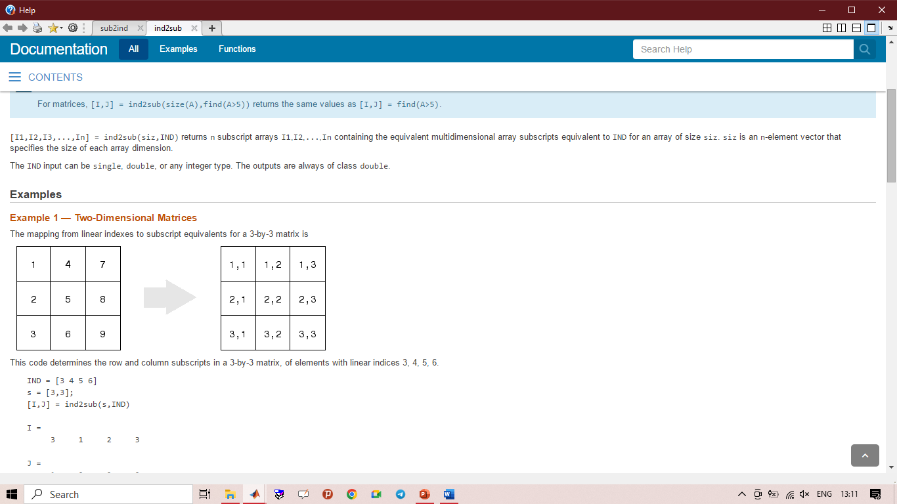
Matrices
Addressing
A = ${[…]}_{3x3}$
A = 〖[…]〗_3𝑥3
[row , col] = ind2sub (size , index);
$a_{22}$ = A (2 , 2);
𝑎_22 = A (2 , 2);
$a_{22}$ = A (5);
𝑎_22 = A (5);
index = sub2ind (size , row , col);
Creating
Measuring
Sz = size (A); [Nrows , Ncolums , …] = size (A);
A = [ $a_{11}$ , $a_{12}$ , … , $a_{1n}$ ; $a_{21}$ , $a_{22}$ , … , $a_{2n}$ ;
A = [ 𝑎_11 , 𝑎_12 , … , 𝑎_1𝑛 ; 𝑎_21 , 𝑎_22 , … , 𝑎_2𝑛 ;
.
.
; $a_{m1}$ , $a_{m2}$ , … , $a_{mn}$];
; 𝑎_𝑚1 , 𝑎_𝑚2 , … , 𝑎_𝑚𝑛];
.
ND = ndims (A);
N = numel (A);
, $\underset{↔}{} Space$
, ↔┴ 𝑆𝑝𝑎𝑐𝑒
; $\underset{↔}{} Enter$
; ↔┴ 𝐸𝑛𝑡𝑒𝑟

Slide 5
Vectors and Matrices – Functions
cat, horzcat, vertcat
zeros, ones, eye
rand, randn, randi, rng
perms, randperm
repmat, reshape, shiftdim, (i)permute, flip
sparse, sprand, sprandsym, full, diag

Slide 6
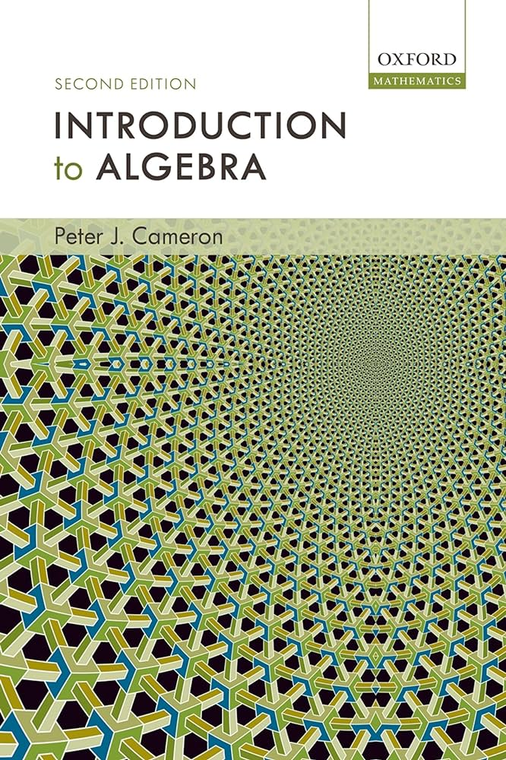
[Linear]+[Algebra]
Source:
Linear Algebra: Foundations of Machine Learning
Paul A. Jensen
University of Illinois
http://jensenlab.net/teaching/#bioe210

Slide 7
Linear Algebra
Operators
Functions
min, max, sort, find
sum, mean, prod, cumprod, diff
diag, trace, norm, nnz, nonzeros, all, any
rank, det, inv, pinv
.* | ./ | .^ | * | / | \ | ^ | + | -

Slide 8
Other Types of Arrays - Cell
Cell
A = cell(size);
A = {a1, a2, a3, … ;a4 ,a5 ,a6, …};
amn = A{row#m, column#n};
x = A{row, column}(row, column);

Slide 9
Other Types of Arrays - Table
Table
T = table(Variables);
T = table(‘Size’ , SZ , ‘VariableTypes’ , VarTypes);
Var1 = T.var1; Var1_n = T.var1(n)

Slide 10
Other Types of Arrays - Structure
Structure
A = struct();
A = struct(‘Name1’, Value1/Variable1, ‘Name 2’, … Value2/Variable2, …);
A.a1 = x; A.a2 = y;
X = A.a1; Xn = A.a1(n)

Slide 11
Converting Between Array Types
Matrix to …
mat2str
Cell to …
cell2vec
Structure to …
struct2cell
mat2cell
mat2gray
mat2dec
mat2dataset
mat2im
Cell2mat
cell2struct
cell2table
cell2dataset
cell2sym
cell2sos
Struct2table
Struct2dataset
Struct2geotable

